Slide 1
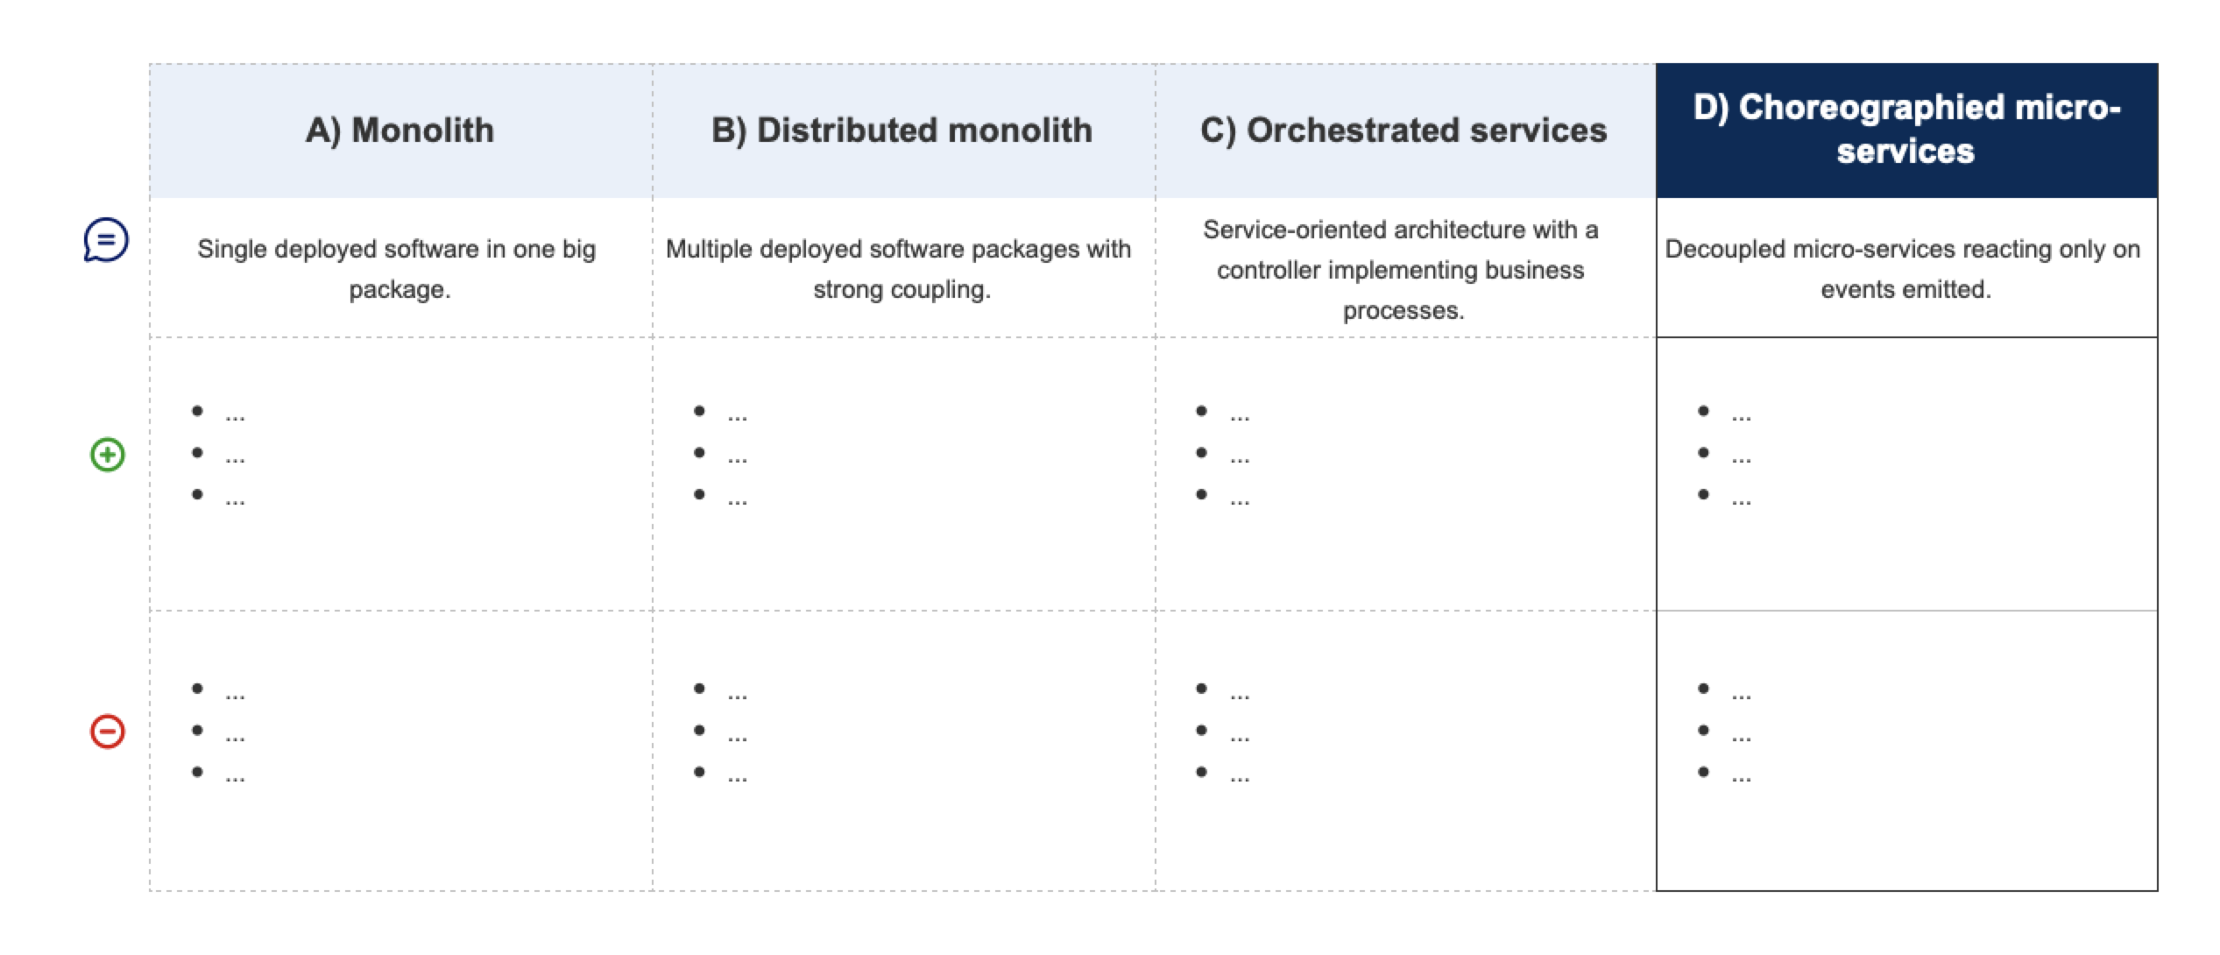
Using [solution D] we spare cost X over Y months with expected [KPI] change by Z%.

Slide 2
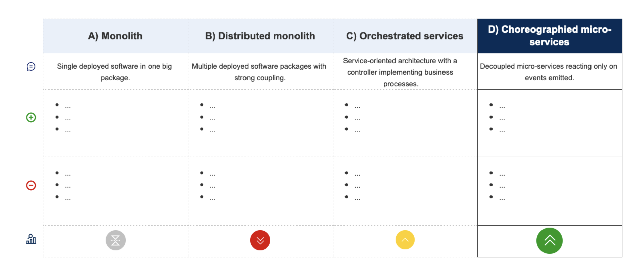
Using [solution D] we spare cost X over Y months with expected [KPI] change by Z%.

