Slide 1
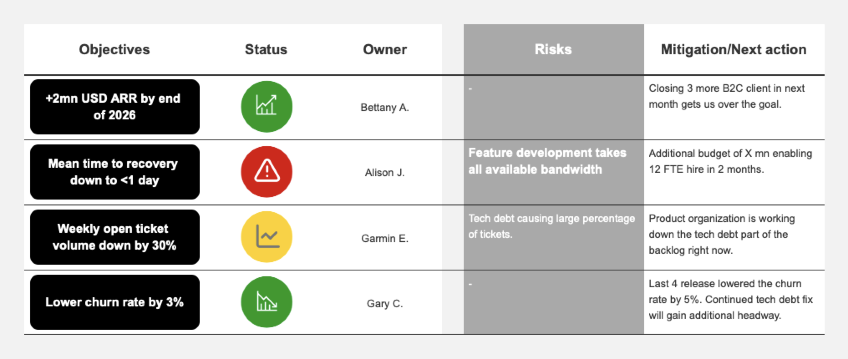
Product delivery requires immediate decision on priorities to get back on track with their objective by Q3, currently conflicted with customer success’ bandwidth needs.

