Slide 1
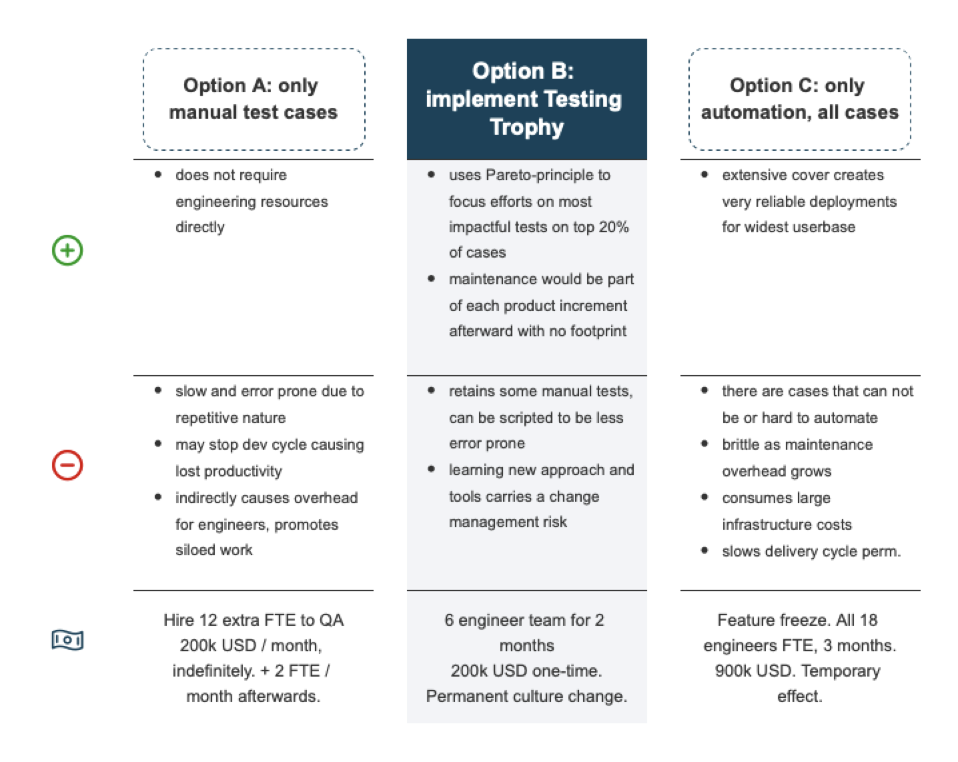
We need to implement Testing Trophy approach to bring down the defects reaching production by 20%. This effort of 6 engineer will increase retention by 5% and earn X million in ARR.

