Slide 1
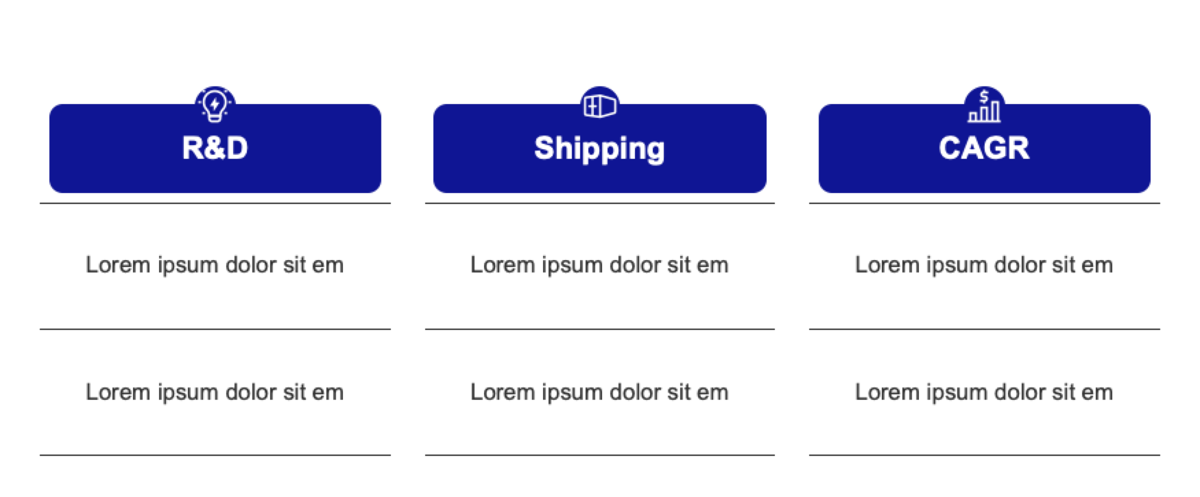
Icons to show elegance on a page:

Slide 2
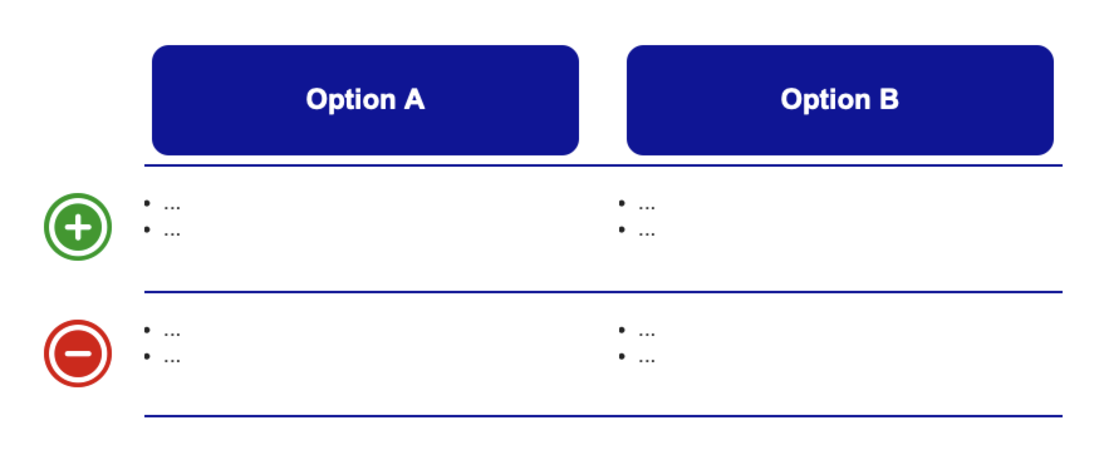
Icons instead of pros-and-cons text:

Slide 3
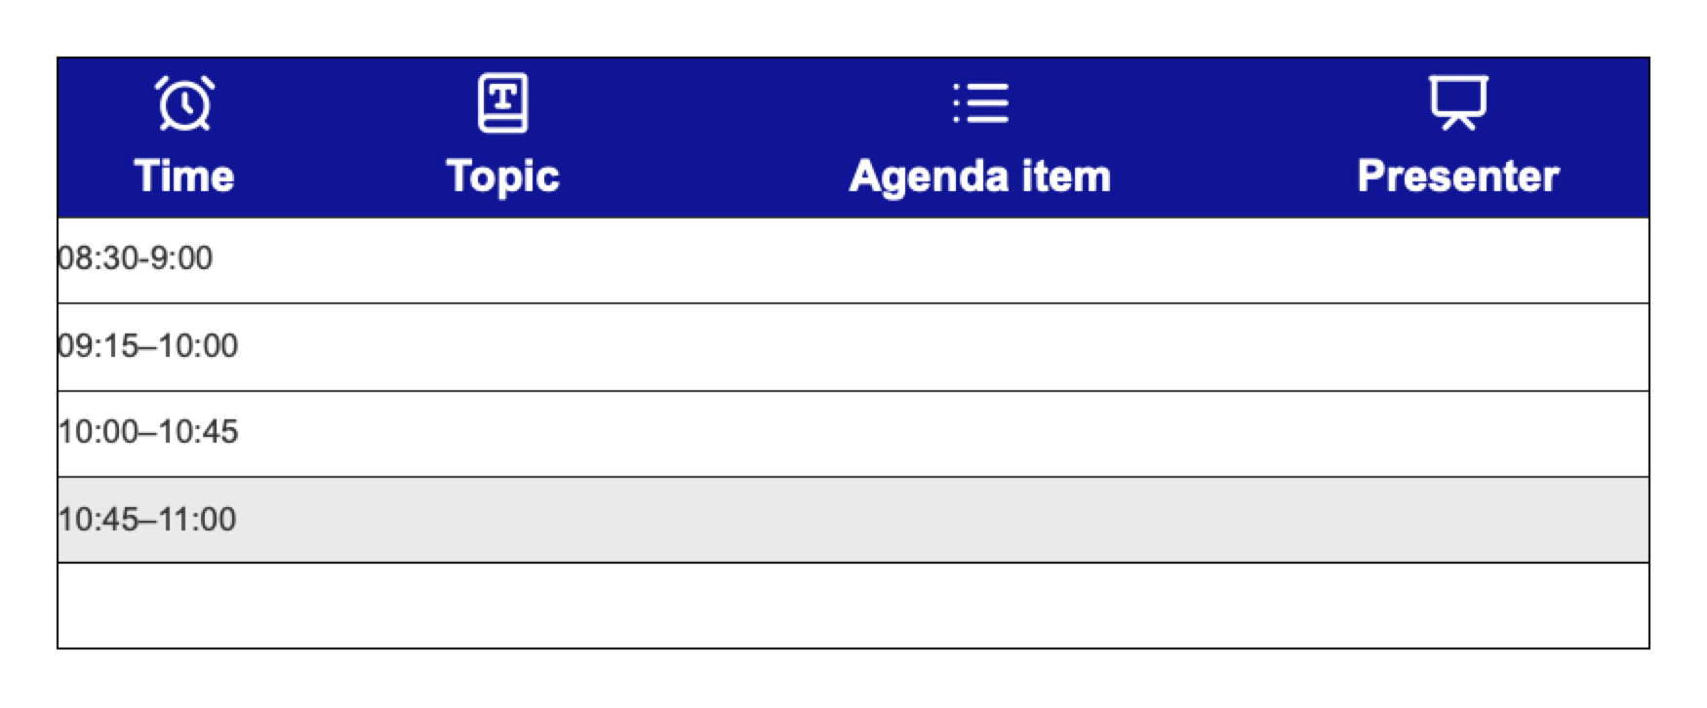
Icons to bring out intent:

